Slide 1
Topic: Quadratics EQ: What is quadratics?

Slide 2
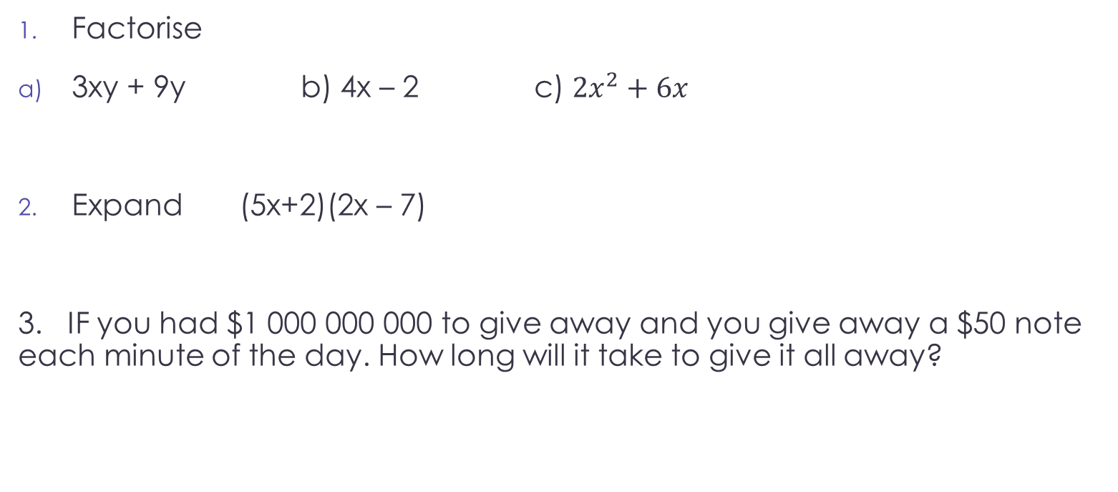
First 5
Factorise
3xy + 9y b) 4x – 2 c) $2x^{2}+6x$
Expand (5x+2)(2x – 7)
3. IF you had $1 000 000 000 to give away and you give away a $50 note each minute of the day. How long will it take to give it all away?

Slide 3
WHY
Quadratic equations are commonplace in theoretical and practical applications of mathematics. They are used to solve problems in geometry and measurement as well as in number theory and physics.
The path that a projectile takes while flying through the air, for example, can be analysed using quadratic equations.

Slide 4
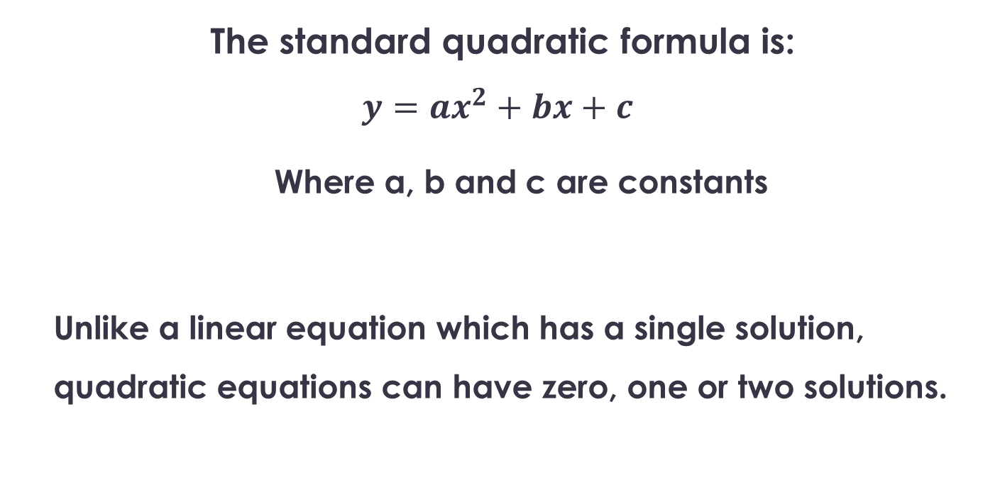
Topic: Quadratics EQ: What is quadratics?
The standard quadratic formula is:
$$y=ax^{2}+bx+c$$
Where a, b and c are constants
Unlike a linear equation which has a single solution, quadratic equations can have zero, one or two solutions.
The formula?
How is it different from a linear equation?

Slide 5
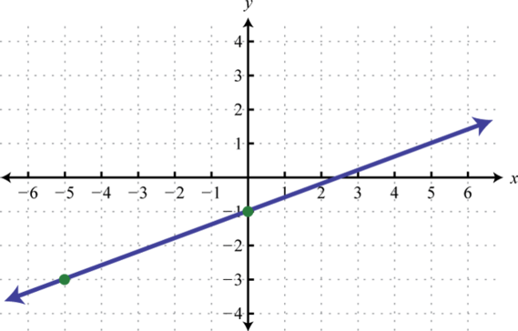
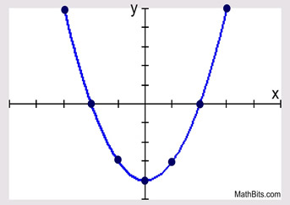
Topic: Quadratics EQ: What is quadratics?
Notes:
Linear:
One x value for every y value
Quadratics:
Two x values for most y values

Slide 6
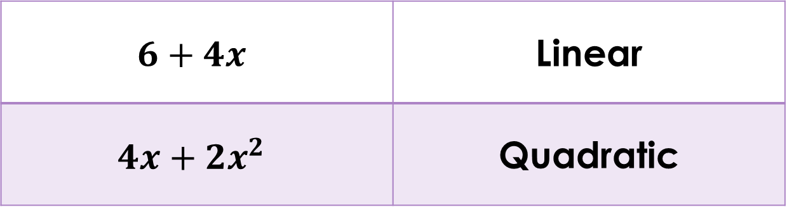
Topic: Quadratics EQ: What is quadratics?
How is it different from a linear equation?
$$6+4x$$ | Linear
$$4x+2x^{2}$$ | Quadratic
Binomial
(power of 2)

Slide 7
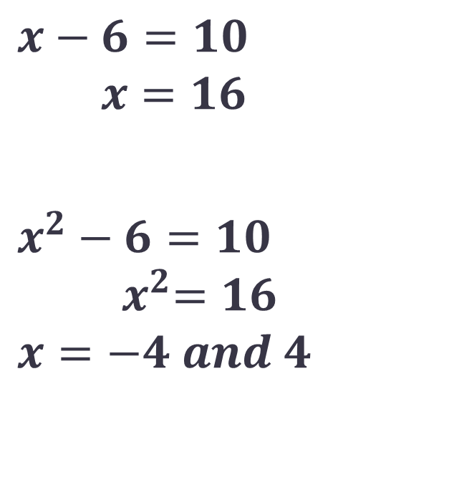
Topic: Quadratics EQ: What is quadratics?
How is it different from a linear equation?
$$x−6=10$$
$$x=16$$
$$x^{2}−6=10$$
$${ x}^{2}=16$$
$$x=−4 and 4$$
Linear
Quadratic

Slide 8
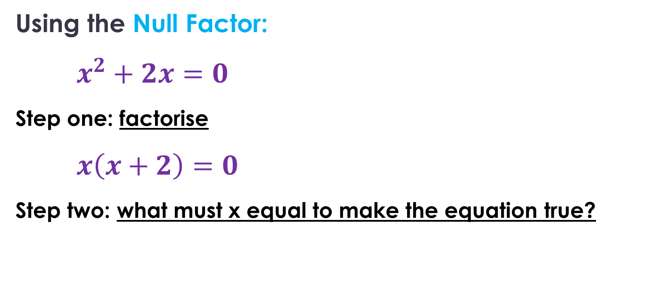
Topic: Quadratics EQ: What is quadratics?
How do I solve quadratic equations?
Using the Null Factor:
$x^{2}+2x=0$
Step one: factorise
$x\left(x+2\right)=0$
Step two: what must x equal to make the equation true?
How?

Slide 9
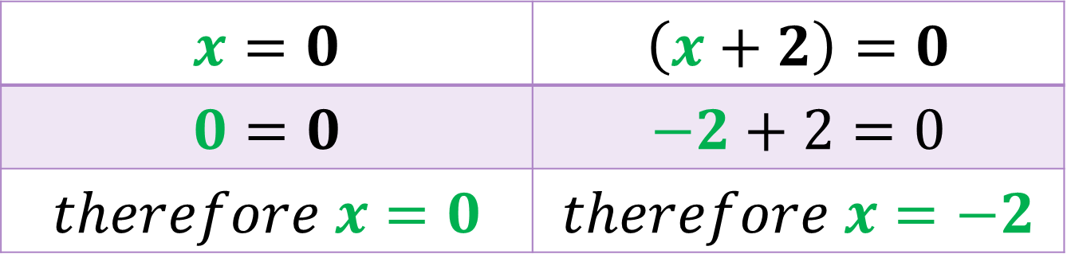

Topic: Quadratics EQ: What is quadratics?
How do I solve quadratic equations?
Using the Null Factor:
$x\left(x+2\right)=0$
$$x=0$$ | $$\left(x+2\right)=0$$
$$0=0$$ | $$−2+2=0$$
$$therefore x=0$$ | $$therefore x=−2$$

Slide 10
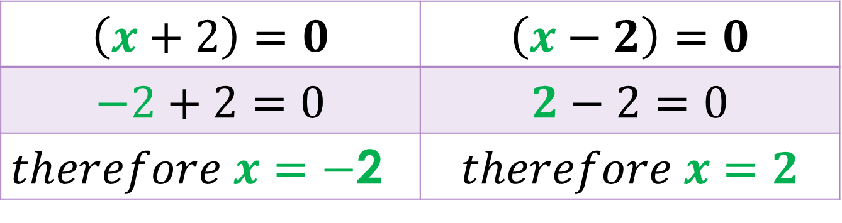

Topic: Quadratics EQ: What is quadratics?
How do I solve quadratic equations?
Using the Null Factor:
$\left(x+2\right)\left(x−2\right)=0$
$$\left(x+2\right)=0$$ | $$\left(x−2\right)=0$$
$$−2+2=0$$ | $$2−2=0$$
$therefore x=−$2 | $$therefore x=2$$

Slide 11
Null Factor on the graph
y = 0
Where y = 0 there are two x values.
For this graph x = -2 and 2

Slide 12
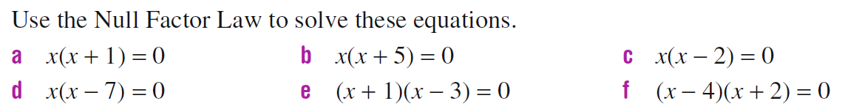
Left-Hand-Side

Slide 13
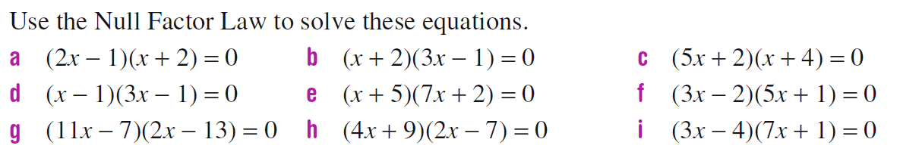
Left-Hand-Side

